Slide 1
Best Salesman 2014-15
File created on: 1/3/2021 10:07:50 AM

Slide 2
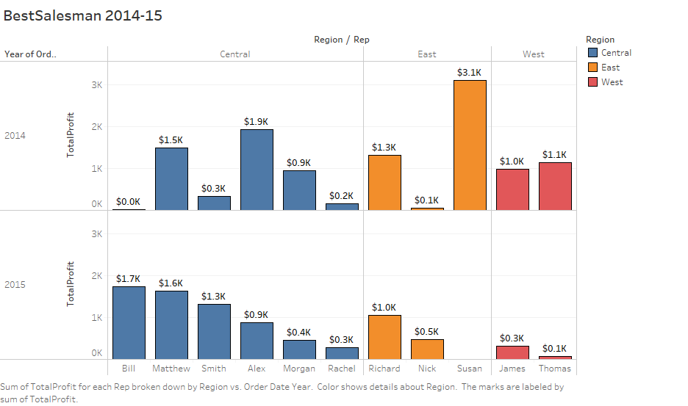

Slide 3
